Slide 1
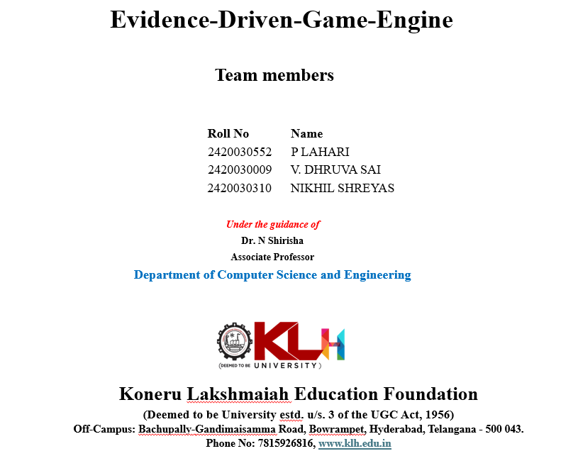

Slide 2

Abstract
Cricket generates enormous ball-by-ball data, but most of it stays locked in raw scorecards, leaving deeper insight largely unexplored. EDGE – Evidence-Driven Game Engine turns this raw data into simple, actionable insights through an AI-powered cricket intelligence platform, built on 800,000+ deliveries, 5,000+ player profiles, and 4,500+ matches spanning multiple formats and years. The platform's AI Match Situation Advisor and Bowling Change Recommender deliver tactical, decision-support insights without requiring users to have data expertise.
EDGE is supported by a Live Match Centre, ICC Rankings, an IPL Franchise Intelligence Hub, and a chase win-probability simulator, all built on a structured, repeatable data pipeline that keeps information current and lets new seasons be added seamlessly as the platform grows. An interactive interface with AI-generated player biographies and leaderboard visualizations lets fans and analysts explore player careers in more depth. Future enhancements include real-time ball-by-ball ingestion, advanced predictive analytics, and dedicated player-performance prediction models.
Evidence-Driven Game Engine (EDGE) | AI-Powered Cricket Intelligence Platform
2

Slide 3
Introduction
Cricket produces a huge amount of structured and unstructured data every match, but this has traditionally been used only for scorecards and basic leaderboards, leaving most valuable insight unexplored. Growth in fantasy sports, franchise scouting, and fan engagement is driving demand for simple, accessible analytics. EDGE – Evidence-Driven Game Engine converts ball-by-ball data into actionable insight through a data pipeline and web app that collects, processes, and analyses large-scale cricket data, calculates key statistics, shows live match information, and uses generative AI for understandable tactical recommendations — without requiring users to have data or cricket expertise.
PostgreSQL with Prisma ORM stores structured cricket data, while a Python-based ETL pipeline extracts, cleans, transforms, and loads Cricsheet JSON files and career statistics; live information comes from CricAPI and RapidAPI, and Google Gemini with Anthropic Claude provide AI-based match analysis and recommendations. Fans, fantasy users, and analysts otherwise rely on scattered sources — scorecards, stats, rankings, news — that rarely combine historical data, live match state, and AI reasoning in one place; manually analysing thousands of ball-by-ball records is slow and needs domain expertise, and EDGE reduces this complexity through one interactive platform.
Evidence-Driven Game Engine (EDGE) | AI-Powered Cricket Intelligence Platform
3

Slide 4
Objectives with Justification
The main objective of EDGE is to develop an AI-powered cricket intelligence platform that transforms raw ball-by-ball data into meaningful, actionable insight. It integrates historical and live cricket data from multiple sources — CricAPI, RapidAPI, and Cricsheet — across matches, players, teams, and formats, through a structured ETL pipeline that collects, cleans, transforms, validates, and stores large-scale cricket datasets. Ball-by-ball data is analysed to identify player performance, team trends, match patterns, and match-state features, and this feeds AI-powered decision support — the Match Situation Advisor and Bowling Change Recommender — that combines live match conditions with historical data and win-probability analysis for contextual tactical insight, delivered through an interactive platform with a Live Match Centre, rankings, player profiles, franchise insights, and visualizations.
The project is justified because cricket generates enormous volumes of ball-by-ball data that stays locked in raw scorecards, and turning it into useful insight manually is slow and requires domain or data-science expertise — keeping deeper analysis out of reach for most fans and even smaller franchises. Existing tools are largely pre-match or post-match, offer little real-time reasoning, and force users to switch between fragmented sources for scorecards, stats, rankings, and live data. By building a self-updating platform that fuses historical depth with live context and AI reasoning, EDGE gives coaches, analysts, and fans faster, more informed, and explainable decision support as a match unfolds, while remaining a scalable foundation for new seasons, leagues, formats, and predictive analytics.
Evidence-Driven Game Engine (EDGE) | AI-Powered Cricket Intelligence Platform
4

Slide 5
Literature and Survey
Authors | Title of the Paper | Link for reference | Drawbacks | Future work
Ashish V Shenoy, Arjun Singhvi, Shruthi Racha, Srinivas Tunuguntla | Prediction of the outcome of a Twenty-20 Cricket Match : A Machine Learning Approach | https://arxiv.org/abs/2209.06346 | Limitation: Focuses mainly on pre-match information rather than continuously changing match state. | Future: Incorporate ball-by-ball/live match features for dynamic prediction.
S. Chakraborty et al. (2024) | Cricket Data Analytics: Forecasting T20 Match Winners Through Machine Learning | https://doi.org/10.1177/17479541221119738 | Limitation: Primarily predicts before the match begins; limited real-time match-state reasoning. | Future: Extend prediction using live ball-by-ball features and dynamic match conditions
Pussella et al. (2023) | In-game Winner Prediction and Winning Strategy Generation in Cricket: A Machine Learning Approach | https://ieeexplore.ieee.org/document/10705216/ | Limitation: Dataset is limited to IPL matches from 2008–2020. | Future: Extend across formats, leagues and more recent matches; incorporate richer contextual features.
Evidence-Driven Game Engine (EDGE) | AI-Powered Cricket Intelligence Platform
5

Slide 6
Authors | Title of the Paper | Link for reference | Drawbacks | Future work
K. Dhinakaran, S. Anbuchelian | Enhanced Cricket Match Prediction Using Kernel Methods for Feature Extraction and Back-Propagation Neural Networks | https://www.nature.com/articles/s41598-026-36555-6 | Limitation: Validated only on ODI matches using six match-state features. | Future: Extend the framework to T20/IPL with added contextual features like pitch and weather.
Jhansi Rani P., Apurva Kulkarni, Aditya V. Kamath, Aadith Menon, Prajwal Dhatwalia, Rishabh D | Prediction of Player Price in IPL Auction Using Machine Learning Regression Algorithms | https://ieeexplore.ieee.org/document/9198668/ | Limitation: Price predicted from past stats only, ignoring current form or bidding demand. | Future: Add real-time form and demand-based features to the pricing model.
Gaurav Malhotra | A Comprehensive Approach to Predict Auction Prices and Economic Value Creation of Cricketers in the IPL | https://journals.sagepub.com/doi/10.3233/JSA-200580 | Limitation: Uses linear regression, limiting capture of non-linear price-performance relationships. | Future: Apply advanced ML/ensemble models with continuously updated in-season data.
Evidence-Driven Game Engine (EDGE) | AI-Powered Cricket Intelligence Platform
6

Slide 7
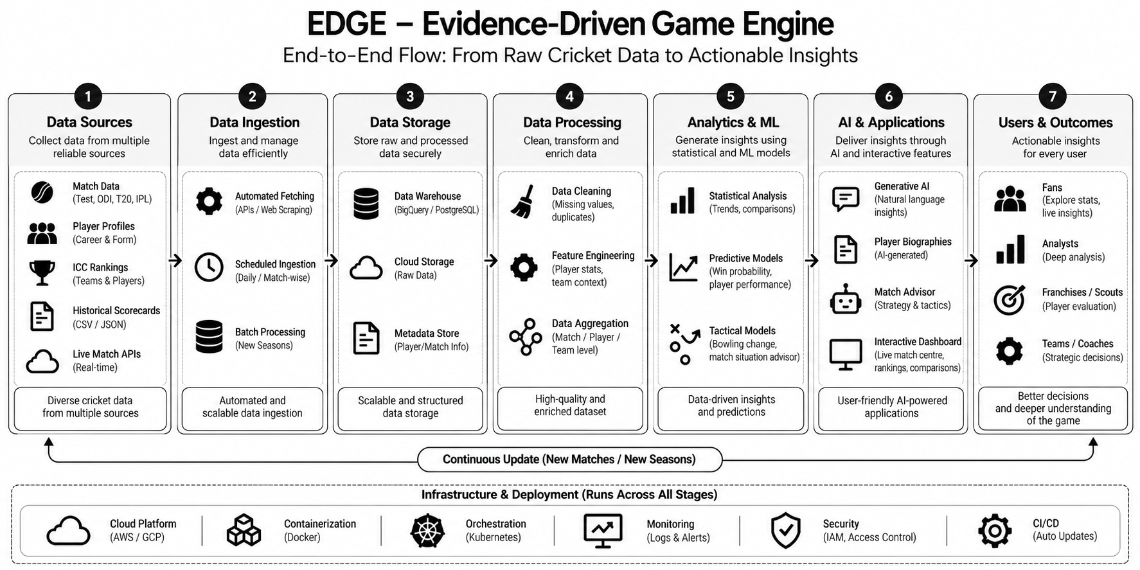
Methodology – Evidence-Driven Game Engine (EDGE)
Evidence-Driven Game Engine (EDGE) | AI-Powered Cricket Intelligence Platform
7

Slide 8
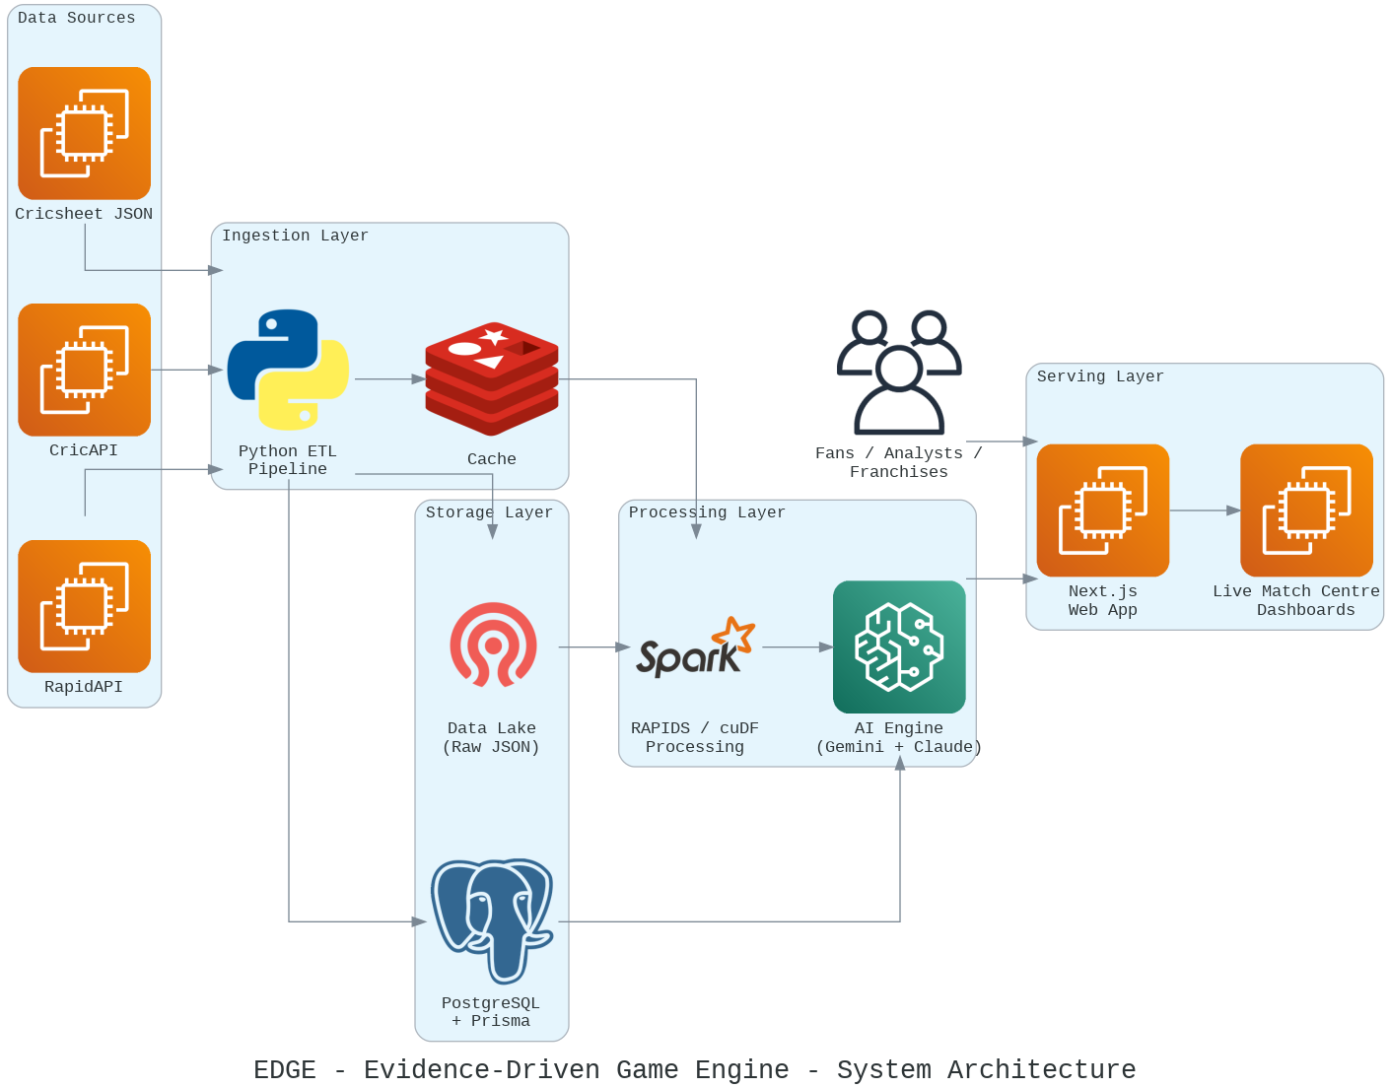
Evidence-Driven Game Engine – System Architecture
Evidence-Driven Game Engine (EDGE) | AI-Powered Cricket Intelligence Platform
8

Slide 9
Existing Solutions
• Static Scorecards & Dashboards (e.g., Cricbuzz, ESPNcricinfo) – provide ball-by-ball scorecards, player statistics and post-match dashboards.
• Pre-match Prediction Models (e.g., Shenoy et al., Chakraborty et al.) – predict match outcomes using historical data and team features.
• In-game Prediction Systems (e.g., Pussella et al.) – extend prediction during matches using changing conditions, mainly for IPL.
• Fantasy & Scouting Platforms (e.g., Dream11, CricHeroes) – provide raw player stats, rankings and past performance data.
• Auction & Player Valuation Models – estimate player values using historical performance and ML models.
Limitations of Existing Systems
• Static / post-match focus – most platforms stop updating once the match begins, offering little real-time intelligence.
• Limited real-time support – few systems provide actionable tactical recommendations as the match state changes ball by ball.
• Narrow data coverage – often restricted to a single league, format or short date range (e.g., IPL 2008–2020).
• No contextual reasoning – platforms show raw stats and rankings, leaving users to interpret trends manually.
• Fragmented sources and an expertise barrier – users switch between disconnected tools, and turning raw data into insight still needs cricket or data-science expertise.
Evidence-Driven Game Engine (EDGE) | AI-Powered Cricket Intelligence Platform
9

Slide 10
Proposed System
The proposed system, EDGE (Evidence-Driven Game Engine), unifies historical and live cricket data with generative AI to deliver continuously updated, explainable tactical insights throughout a match. It combines 800,000+ deliveries, 5,000+ player profiles, and live CricAPI/RapidAPI feeds with an AI Match Situation Advisor and Bowling Change Recommender, so guidance stays relevant ball by ball rather than only before the match.
A single, self-updating platform brings the Live Match Centre, ICC Rankings, IPL Franchise Intelligence Hub, and win-probability simulator together, removing the need to switch between fragmented sources. A structured, repeatable Python-based ETL pipeline extracts, cleans, transforms, and loads data into PostgreSQL with Prisma ORM, keeping information current and letting new seasons, formats, and leagues be added without manual rework, while an interactive interface with AI-generated player biographies and visualizations makes deep cricket analysis accessible without requiring cricket or data-science expertise.
Evidence-Driven Game Engine (EDGE) | AI-Powered Cricket Intelligence Platform
10

Slide 11
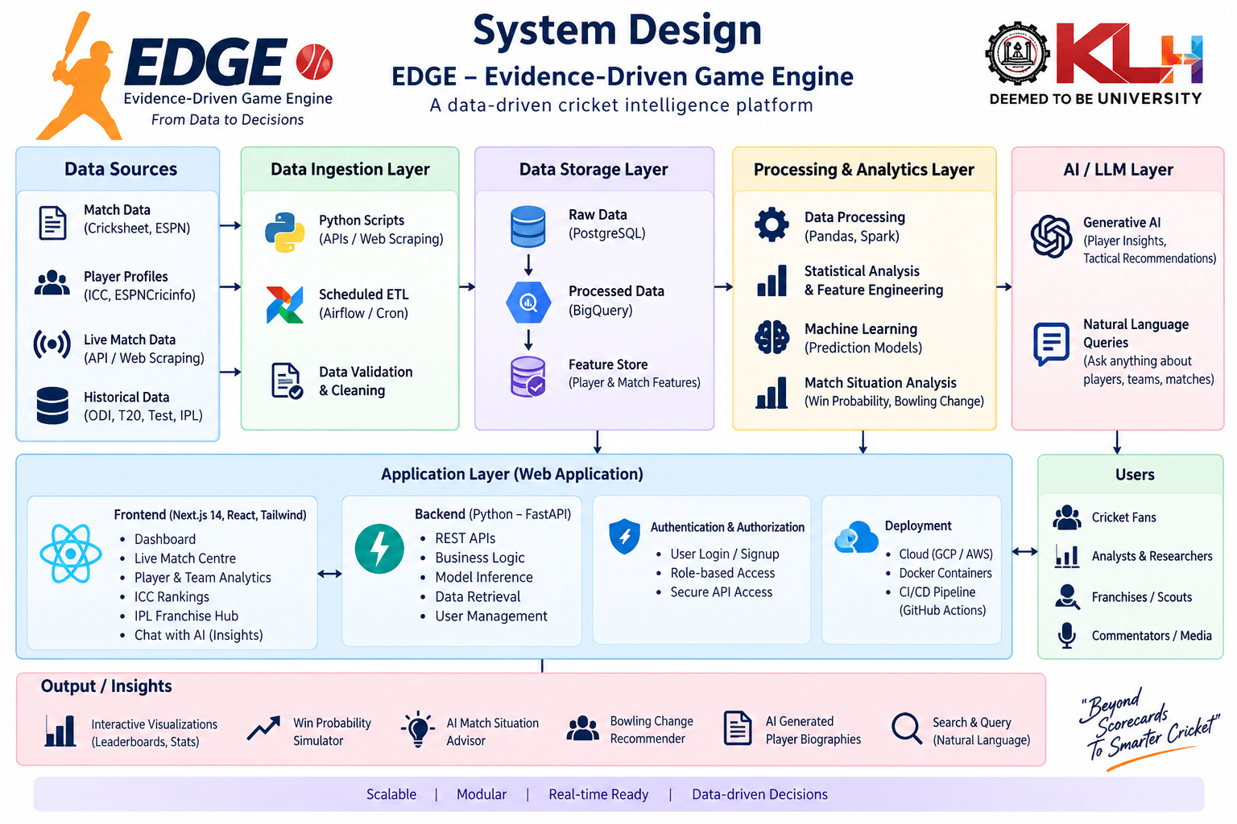


System Design :

Slide 12
Software Requirements
Software | Purpose
Operating System | Windows 10/11 or Linux
Next.js / React | Frontend and backend web application, server-side rendering
Python 3.x | ETL pipeline development and data processing
RAPIDS / cuDF | GPU-accelerated processing of large historical datasets
PostgreSQL | Structured, query-ready data storage
Prisma ORM | Type-safe schema and database queries
Google Gemini / Anthropic Claude | Generative AI reasoning for tactical recommendations
CricAPI, RapidAPI | Live match and score data feeds
Node.js | JavaScript runtime for the web application
Git & GitHub | Version control and project management
Evidence-Driven Game Engine (EDGE) | AI-Powered Cricket Intelligence Platform
11

Slide 13
Hardware Requirements
Component | Minimum Requirement
Processor | CUDA-compatible GPU-enabled server; multi-core CPU
RAM | 16 GB recommended for ETL and database operations
Storage | SSD recommended for the data lake and database
Internet | Reliable broadband for CricAPI/RapidAPI feeds and AI model calls
Display | Any modern device / standard display — client is browser-based
Server-side compute | GPU acceleration (RAPIDS/cuDF) for large historical datasets
Evidence-Driven Game Engine (EDGE) | AI-Powered Cricket Intelligence Platform
12

Slide 14
Functional Requirements
Ingest and process Cricsheet, CricAPI and RapidAPI data through the ETL pipeline into PostgreSQL and the Data Lake.
Clean, standardize, and validate raw ball-by-ball records before storage.
Generate AI-based tactical recommendations from the current match state.
Display live scores, ICC Rankings, IPL Franchise Intelligence and win-probability through the Live Match Centre.
Provide AI-generated player biographies and leaderboard visualizations.
Support new seasons, formats, and leagues being added without manual rework.
Non-Functional Requirements
Performance: return live updates and AI recommendations with low latency during active matches.
Scalability: handle 800K+ historical deliveries and growing live traffic without degradation.
Reliability: validation and error handling keep the pipeline stable as new sources are added.
Maintainability: modular, repeatable pipeline and component structure.
Usability: interface stays usable without cricket or data-science expertise.
Availability: processed information accessible whenever required.
Evidence-Driven Game Engine (EDGE) | AI-Powered Cricket Intelligence Platform
13

Slide 15
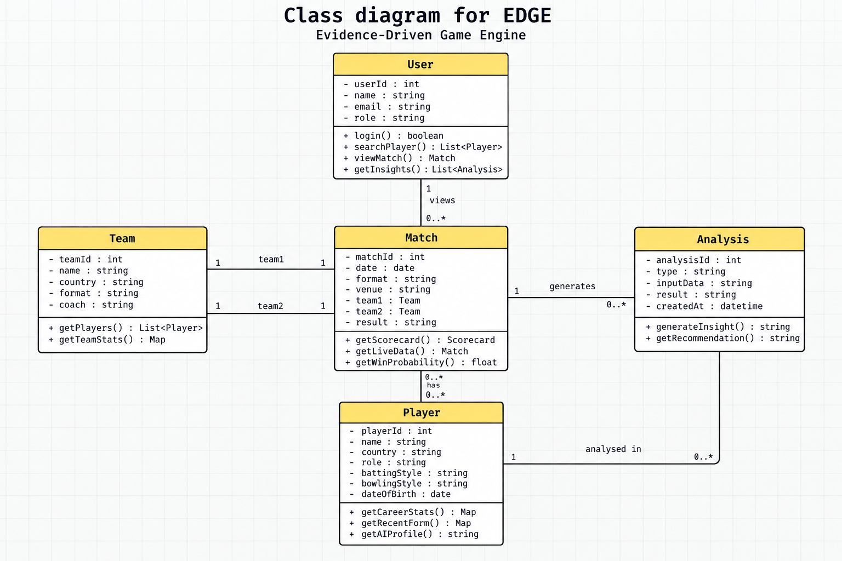
Design – UML Diagram
Evidence-Driven Game Engine (EDGE) | AI-Powered Cricket Intelligence Platform
14

Slide 16
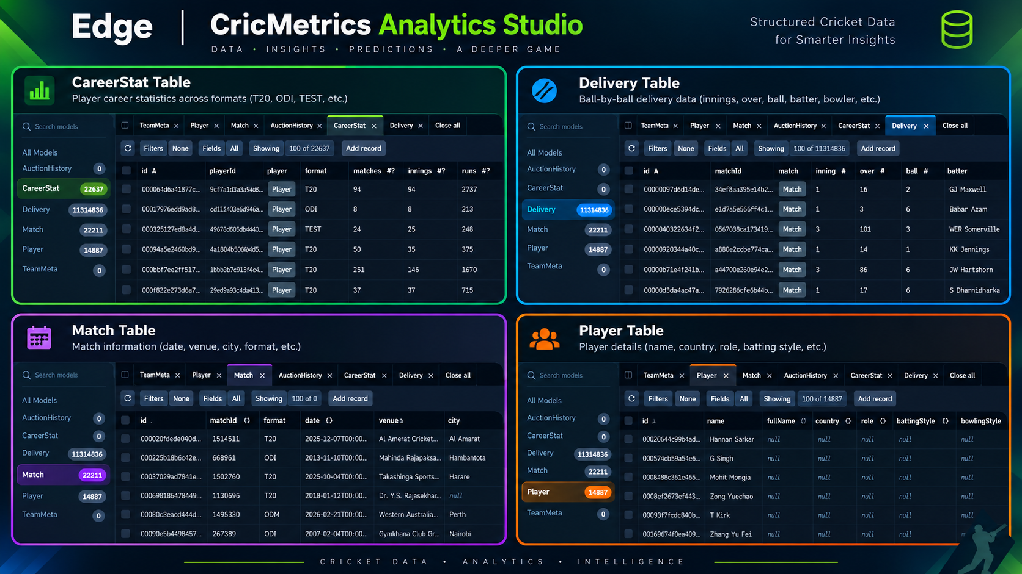
Implementation
Evidence-Driven Game Engine (EDGE) | AI-Powered Cricket Intelligence Platform
15

Slide 17
Coding Quality & Functionality
Coding Quality
Modular separation between the ETL pipeline, database layer, AI engine, and web application.
Prisma ORM enforces type-safe schema and queries end-to-end.
Consistent naming conventions and folder structure across the Next.js app.
Reusable React components across the Live Match Centre and dashboards.
Validation and error handling built into the ETL pipeline for 800K+ deliveries.
Structured, repeatable pipeline lets new seasons be added without code changes.
Live data feeds are checked and cached to protect against upstream outages.
Git/GitHub version control.
Functionality
Live Match Centre with real-time score tracking.
ICC Rankings and the IPL Franchise Intelligence Hub.
Chase win-probability simulator.
AI Match Situation Advisor and Bowling Change Recommender.
AI-generated player biographies and leaderboard visualizations.
Interactive player, team, and franchise analytics.
Data pipeline health and data-quality monitoring.
Evidence-Driven Game Engine (EDGE) | AI-Powered Cricket Intelligence Platform
16

Slide 18
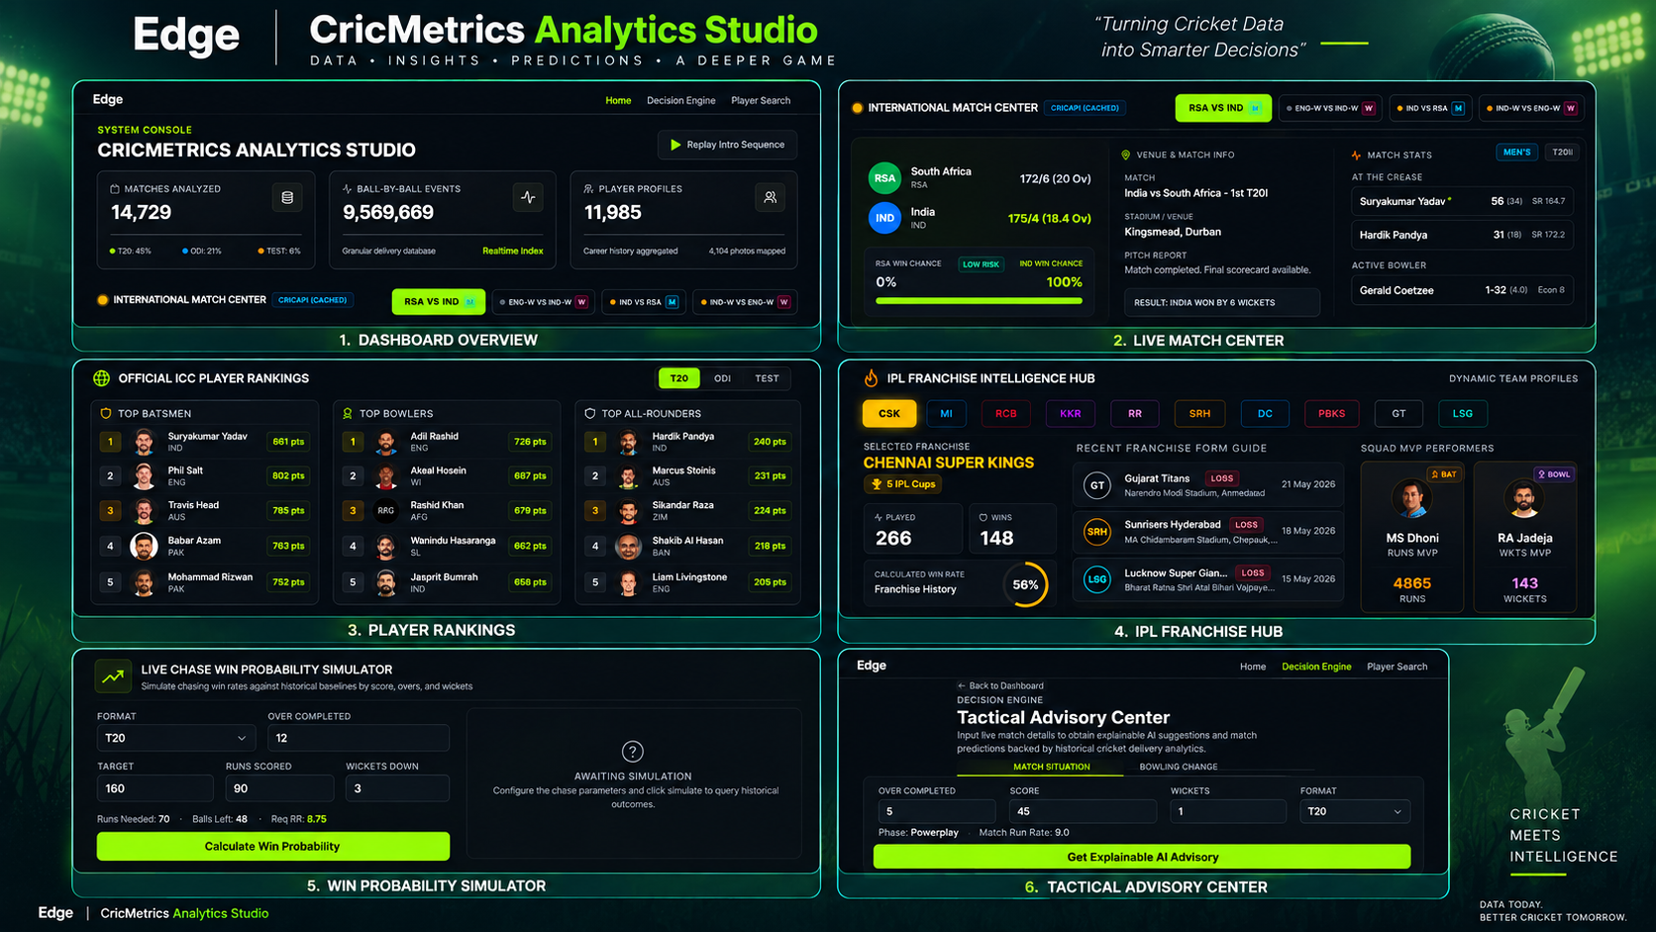
Output Screenshots – EDGE CricMetrics Analytics Studio
Evidence-Driven Game Engine (EDGE) | AI-Powered Cricket Intelligence Platform
17

